Slide 1
Greatest common divisor

Slide 2
Greatest common divisor
In mathematics, the greatest common divisor (gcd) of two or more integers, which are not all zero, is the largest positive integer that divides each of the integers.
For example, the gcd of 16 and 12 is 4.
Two numbers are called relatively prime, or coprime, if their greatest common divisor equals 1.
For example, 9 and 28 are coprime.

Slide 3
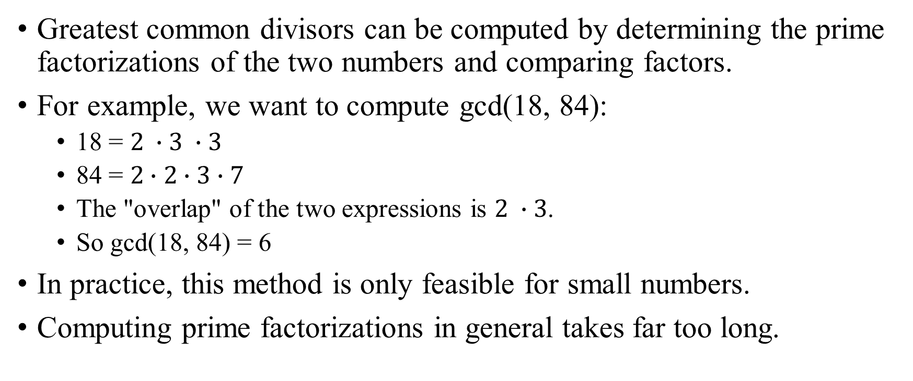
Greatest common divisor Calculation: Prime factorization
Greatest common divisors can be computed by determining the prime factorizations of the two numbers and comparing factors.
For example, we want to compute gcd(18, 84):
18 = $2 ∙3 ∙3$
84 = $2∙2∙3∙7$
The "overlap" of the two expressions is $2 ∙3$.
So gcd(18, 84) = 6
In practice, this method is only feasible for small numbers.
Computing prime factorizations in general takes far too long.

Slide 4
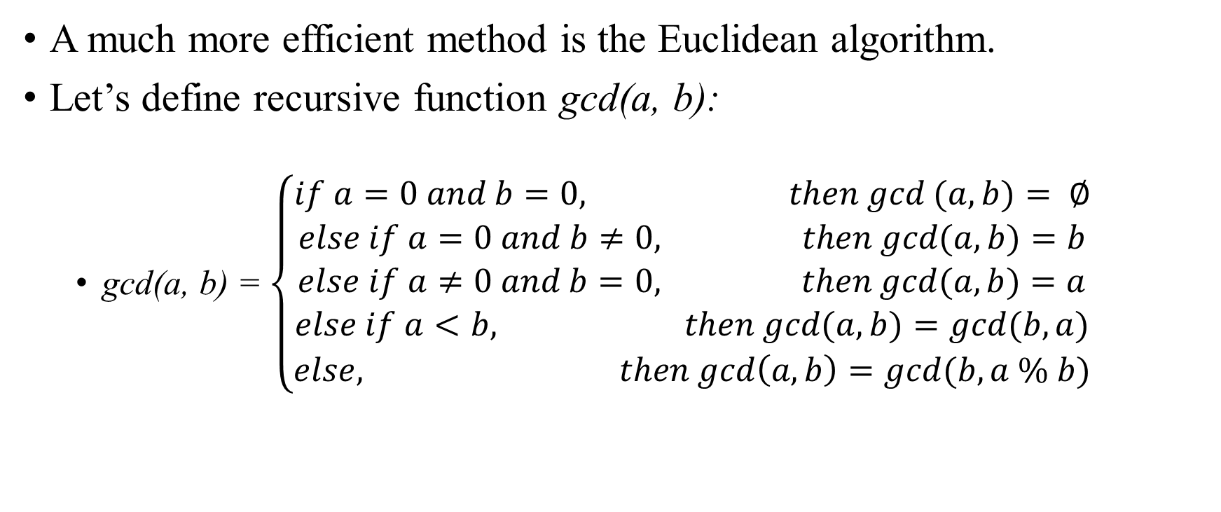
Greatest common divisor Calculation: Euclidean algorithm
A much more efficient method is the Euclidean algorithm.
Let’s define recursive function gcd(a, b):
gcd(a, b) = $\left\{\begin{matrix}if a=0 and b=0, then gcd (a, b)= ∅ \\ else if a=0 and b≠0, then gcd(a, b)=b \\ \begin{matrix}else if a≠0 and b=0, then gcd(a, b)=a \\ else if a<b, then gcd(a, b)=gcd(b, a) \\ else, then gcd\left(a, b\right)=gcd(b, a \% b)\end{matrix}\end{matrix}\right.$

Slide 5
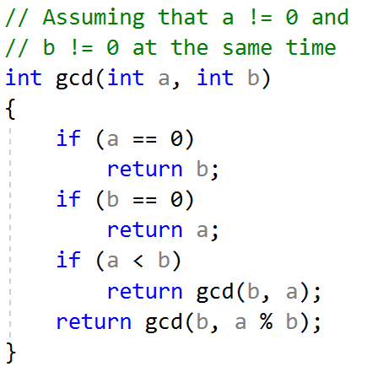
Greatest common divisor Calculation: Euclidean algorithm
For example, we want to compute gcd of 18 and 84:
gcd(18, 84) = gcd(84, 18) = gcd(18, 12) = gcd(12, 6) = gcd(6, 0) = 6.
First draft of code:

Slide 6
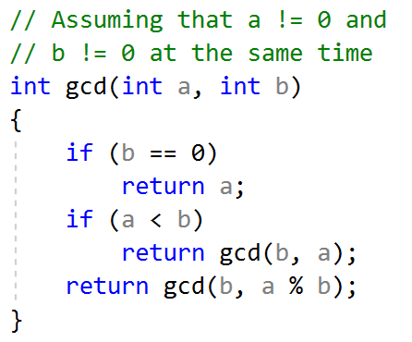
Greatest common divisor Calculation: Euclidean algorithm
Let’s notice, that a can be 0 only when a is 0 at the start. So in this case we can simply swap a and b, and continue our algorithm.
Second draft of code:

Slide 7
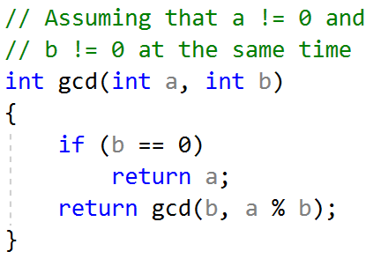
Greatest common divisor Calculation: Euclidean algorithm
Also let’s notice, that if b is greater than a we can skip the swap step, because after algorithm first step we will get the same result.
gcd(18, 84) = gcd(84, 18 % 84) = gcd(84, 18)
Third draft of code:

Slide 8
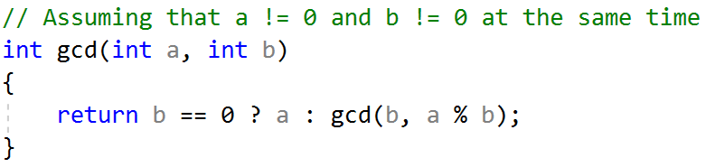

Greatest common divisor Calculation: Euclidean algorithm
And the last thing, we can use ternary operator to simplify this function.
Final code:
Complexity of this algorithm is $O\left(\log{(\min\left(a, b\right))}\right)$. Proof is here.

Slide 9
Least common multiple

Slide 10
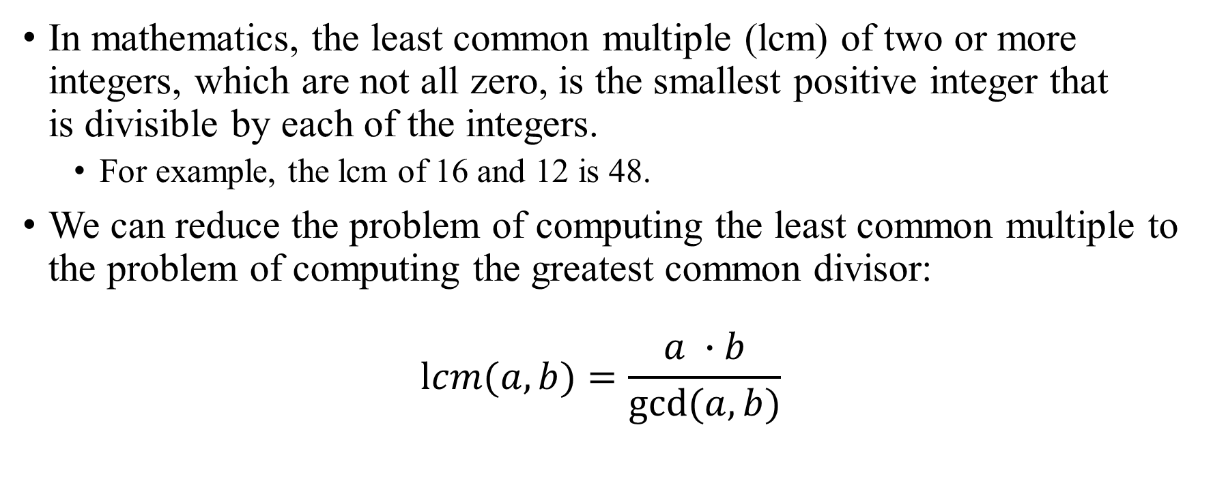
Least common multiple
In mathematics, the least common multiple (lcm) of two or more integers, which are not all zero, is the smallest positive integer that is divisible by each of the integers.
For example, the lcm of 16 and 12 is 48.
We can reduce the problem of computing the least common multiple to the problem of computing the greatest common divisor:
$$lcm(a, b)=\frac{a ∙b}{gcd⁡(a, b)}$$

Slide 11
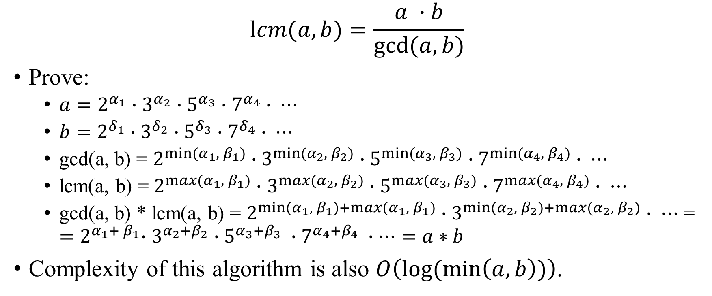
Least common multiple
$$lcm(a, b)=\frac{a ∙b}{gcd⁡(a, b)}$$
Prove:
$a=2^{α_{1}}∙$ $3^{α_{2}}∙$ $5^{α_{3}}∙$ $7^{α_{4}}∙ ⋯$
$b=2^{δ_{1}}∙$ $3^{δ_{2}}∙$ $5^{δ_{3}}∙$ $7^{δ_{4}}∙$ $⋯$
gcd(a, b) = $2^{{min⁡(α}_{1},{ β}_{1})}∙$ $3^{{min⁡(α}_{2},{ β}_{2})}∙$ $5^{{min⁡(α}_{3},{ β}_{3})}∙$ $7^{{min⁡(α}_{4},{ β}_{4})}∙ ⋯$
lcm(a, b) = $2^{{max⁡(α}_{1},{ β}_{1})}∙$ $3^{{max⁡(α}_{2},{ β}_{2})}∙$ $5^{{max⁡(α}_{3},{ β}_{3})}∙$ $7^{{max⁡(α}_{4},{ β}_{4})}∙ ⋯$
gcd(a, b) * lcm(a, b) = $2^{{min⁡(α}_{1},{ β}_{1})+{max⁡(α}_{1},{ β}_{1})}∙$ $3^{{min⁡(α}_{2},{ β}_{2})+{max⁡(α}_{2},{ β}_{2})}$ $∙ ⋯$ = ${=2}^{α_{1}+{ β}_{1}}∙$ $3^{α_{2}+β_{2}}$ $∙5^{α_{3}+β_{3}} ∙7^{α_{4}+β_{4}} ∙⋯=a∗b$
Complexity of this algorithm is also $O\left(\log{(\min\left(a, b\right))}\right)$.

